Slide 1
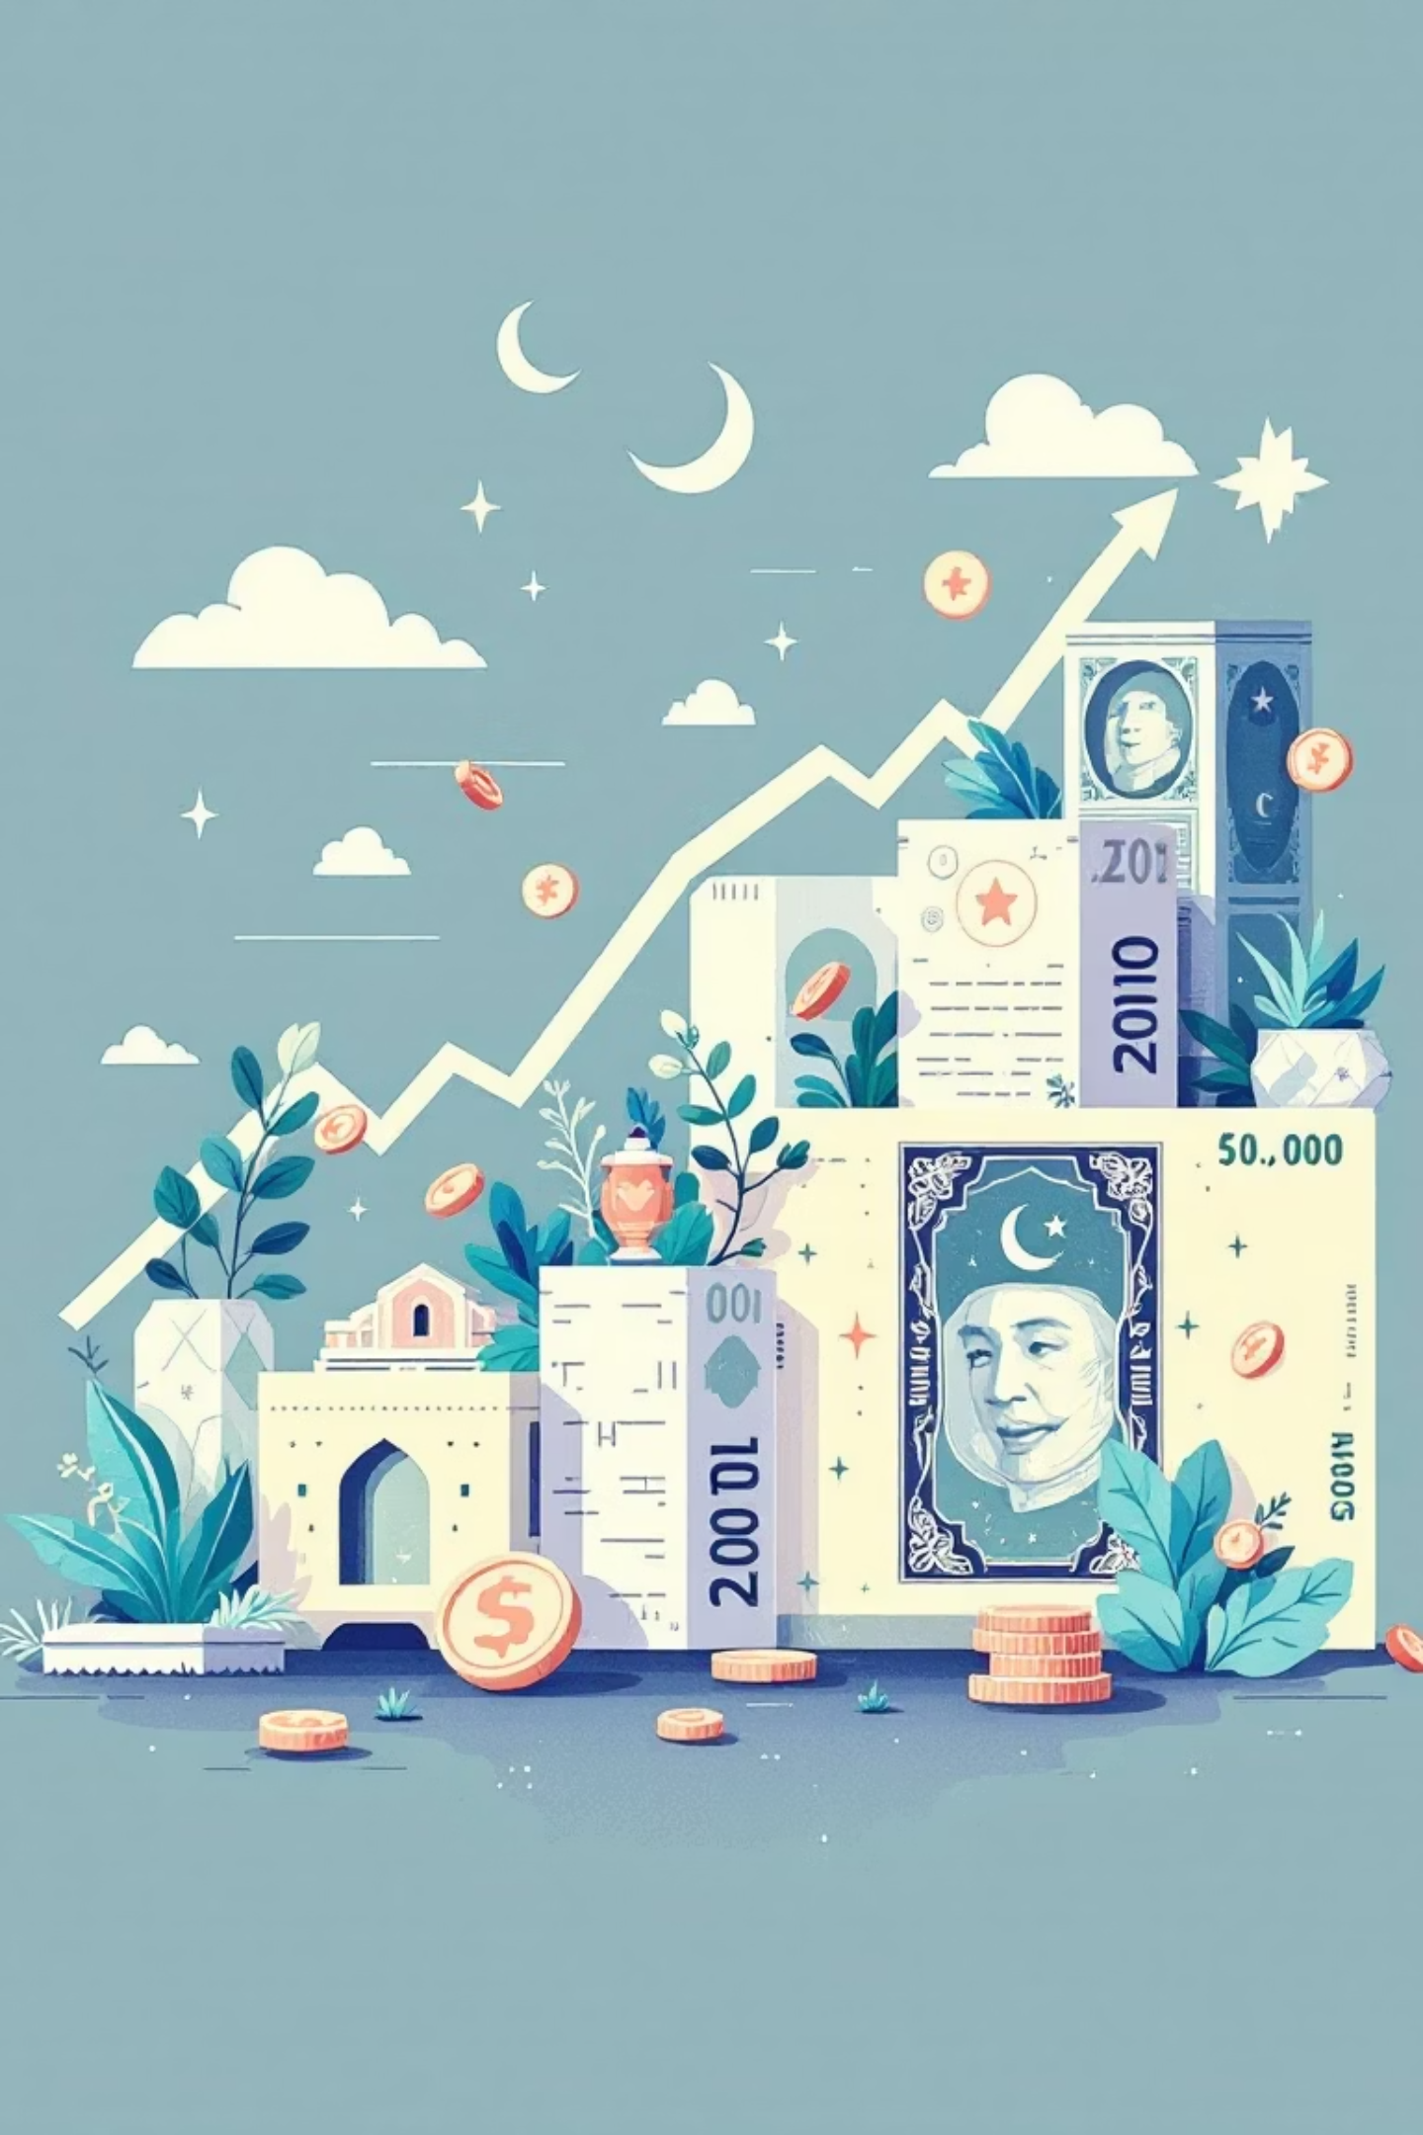
Impact of Interest Rates on Gross Capital Formation Growth in Pakistan
(2001–2024)
Prepared by:
Noor Ul Ain Zahid

Slide 2

Introduction: Interest Rates and Investment in Pakistan
This study investigates the relationship between interest rates and investment in Pakistan from 2001 to 2024. Investment, measured by Gross Capital Formation (GCF), is crucial for economic growth, driving the creation of factories, machines, and jobs.
The primary objective is to determine if a causal relationship exists between changes in the average interest rate and GCF growth, and whether these changes facilitate or hinder business investment.

Slide 3

Hypothesis: Interest Rate's Effect on Capital Formation
Null Hypothesis (H0)
The Average Interest Rate has no statistically significant effect on Gross Capital Formation Growth (β1 = 0).
Alternative Hypothesis (H1)
The Average Interest Rate has a statistically significant negative effect on Gross Capital Formation Growth (β1 ≠ 0).
Our model for analysis is: Capital Formation Growth = β₀ + β₁ (Average Interest Rate) + ε

Slide 4

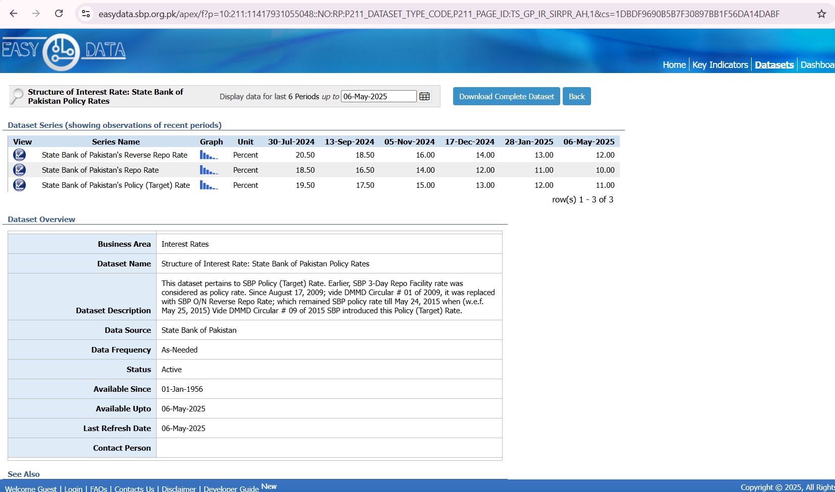
State Bank of Pakistan
https://easydata.sbp.org.pk/apex/f?p=10:211:11417931055048::NO:RP:P211_DATASET_TYPE_CODE,P211_PAGE_ID:TS_GP_IR_SIRPR_AH,1&cs=1DBDF9690B5B7F30897BB1F56DA14DABF
INTEREST RATE
Average interest rate data for 2001–2024 were collected from the official website of the State Bank of Pakistan.

Slide 5

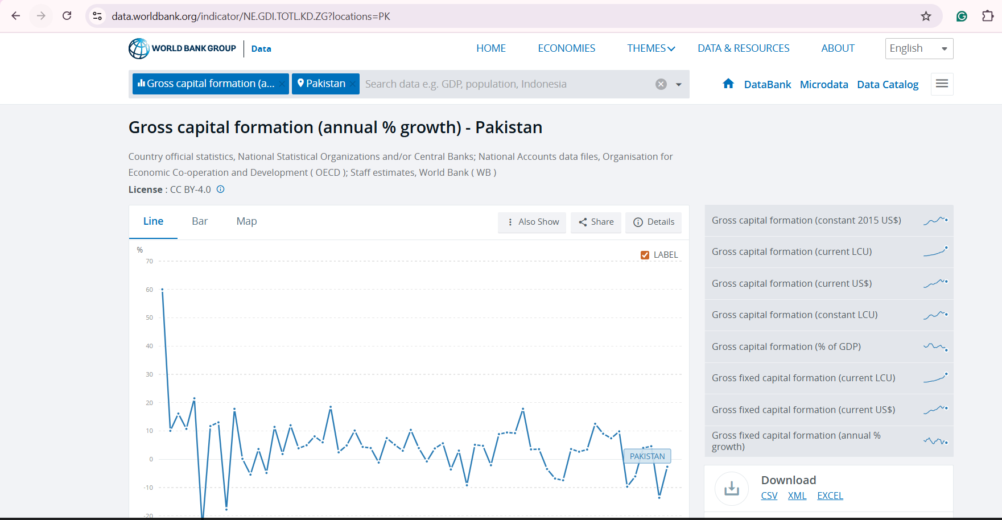
World Bank Database
https://data.worldbank.org/indicator/NE.GDI.TOTL.KD.ZG?locations=PK
Gross Capital Formation (Investment)
Gross Capital Formation (investment) data for 2001-2024 period was sourced from the World Bank database.

Slide 6
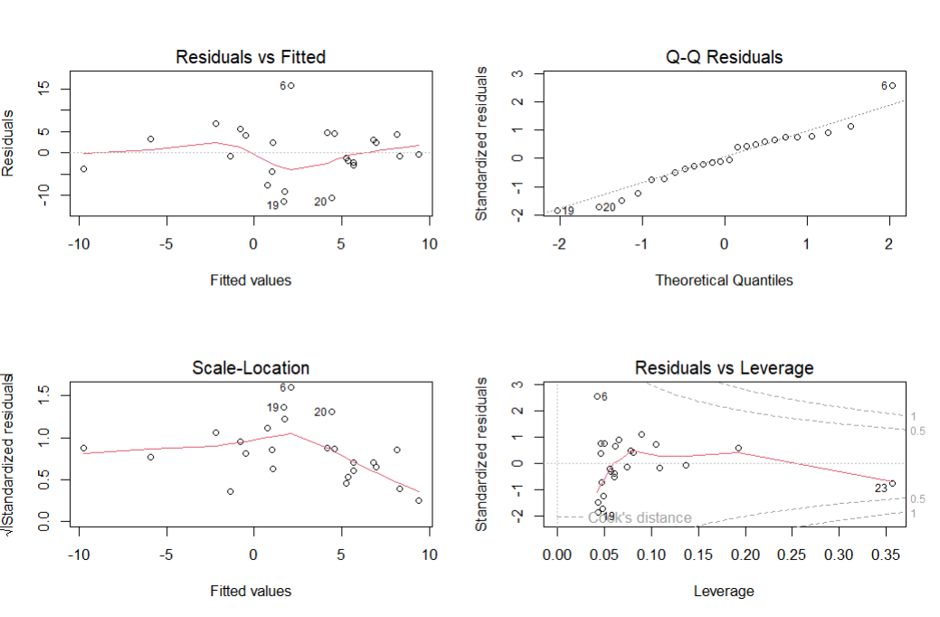
Diagnostic Plots

Slide 7
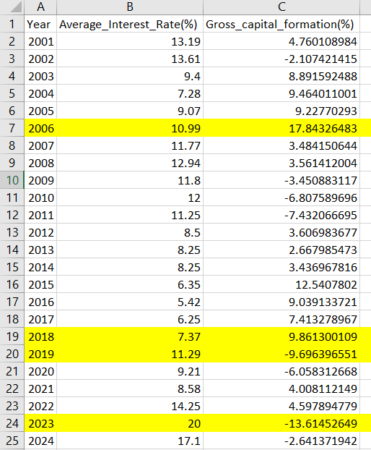
Outliers in Data
2006: Boom due to easy credit & foreign inflows
2018: High growth from CPEC projects
2019: Drop from high interest rates, weaker rupee, fiscal tightening
2023: Crash from 20% interest rate hike to control inflation & balance of payments

Slide 8
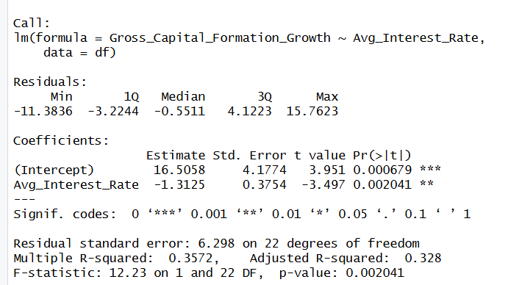
Regression Analysis: Key Findings
Our regression equation is: Capital Formation Growth = 16.50 - 1.3125 (Average Interest Rate) + ε
Intercept (16.50)
When GCF Growth is 0%, the Average Interest Rate is approximately 16.50%. The estimate is moderately precise (SE = 4.1774).
GCF Growth (–1.3125)
For every 1% increase in GCF Growth, the Average Interest Rate decreases by 1.3125%. This slope estimate is reliable (SE = 0.3754).

Slide 9
Regression Analysis: Significance and Model Fit
1
2
3
Statistical Significance
Residual Standard Error
R-squared (0.357)
Both coefficients are statistically significant (p < 0.05), indicating the relationship is unlikely due to chance.
The model's predicted GCF Growth deviate from actual by about 6.298 % on average.
About 35.7% of the variation in GCF Growth is explained by Interest Rates .
4
5
Adjusted R-squared (0.328)
F-statistic (12.23, p = 0.002)
The adjusted value, accounting for sample size, is slightly lower at 32.8%.
The model is statistically significant overall, meaning Average Interest Rate reliably predicts GCF Growth.

Slide 10
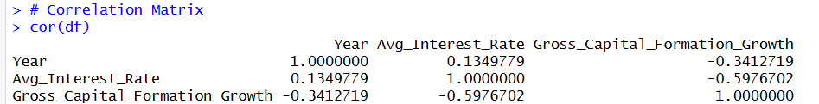
Correlation Matrix: Relationships Between Variables
Avg Interest Rate & GCF Growth
–0.598
Moderate negative relationship: when investment growth increases, interest rates tend to decrease.
Year & Avg Interest Rate
0.135
Very weak positive relationship: interest rates slightly increase over time, but not strongly.
Year & GCF Growth
–0.341
Weak negative relationship: Investment growth slightly decreases over the years.

Slide 11
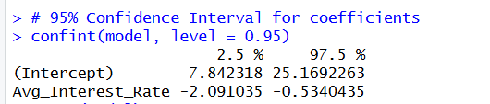
95% Confidence Interval: Precision of Estimates
Intercept (7.84 – 25.16)
We are 95% confident that when Average Interest Rate is 0%, the GCF Growth lies between 7.84% and 25.16%.
GCF Growth (–2.09 – –0.534)
We are 95% confident that for every 1% increase in Average Interest Rate, the GCF Growth decreases between 0.534% and 2.09%. This confirms a negative relationship.

Slide 12

Real-World Applications of Research
Understanding the link between interest rates and investment is vital for informed decision-making by policymakers and businesses.
01
02
03
For Policymakers
For Businesses and Investors
For Economic Planning
Central banks can adjust interest rates to encourage economic growth. Lowering rates can stimulate business investment in infrastructure and technology.
Companies can strategically plan borrowing and investment based on interest rate trends. Falling rates present opportunities for expansion.
Governments can leverage this knowledge to promote job creation and economic development by effectively managing the cost of capital.
This research connects interest rate policy with real investment behavior, crucial for boosting Pakistan’s economic growth.

